Slide 1
Lab 11-1 Convolution Neural Network & Data Pipelines
NTHU DataLab, 2024

Slide 2
Outline
Convolution neural network
Input pipeline
Optimization for Input pipeline

Slide 3
Outline
Convolution neural network
Input pipeline
Optimization for Input pipeline

Slide 4
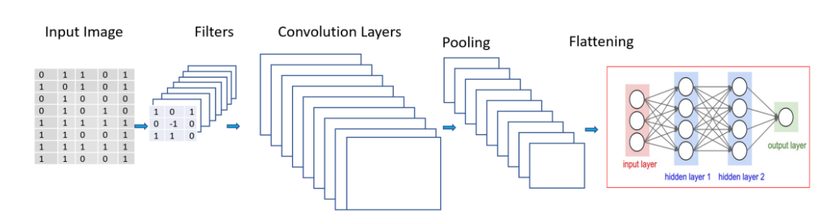
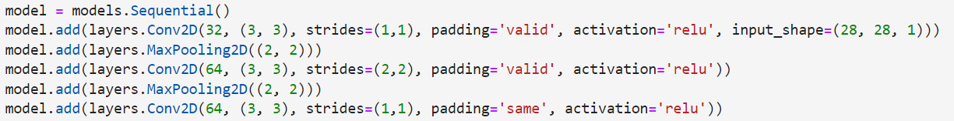
Convolution Neural Network
Build a CNN model via Sequential API
A stack of Conv2D and MaxPooling2D layers

Slide 5
Convolution Neural Network
Build a CNN model via Sequential API
A stack of Conv2D and MaxPooling2D layers
Width * Height * Channel

Slide 6
Convolution Neural Network
Build a CNN model via Sequential API
A stack of Conv2D and MaxPooling2D layers
Filters: the number of output filters in the convolution

Slide 7
Convolution Neural Network
Build a CNN model via Sequential API
A stack of Conv2D and MaxPooling2D layers
Kernel size: specifying the height and width of the 2D convolution window

Slide 8
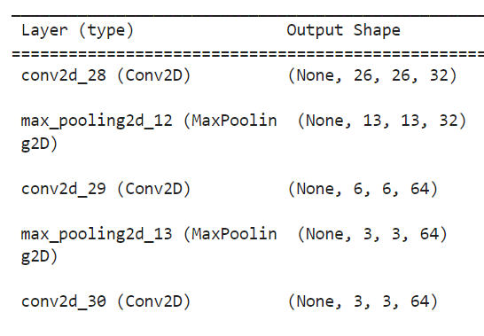
Convolution Neural Network
Build a CNN model via Sequential API
A stack of Conv2D and MaxPooling2D layers
(Default value)

Slide 9
Convolution Neural Network
Build a CNN model via Sequential API
A stack of Conv2D and MaxPooling2D layers
0
0
0
0
1
10
1
9
1
-1
10
1
3
8
-1
0
8
0
0
5
-3
-1
-1
8
1
-1
4
-6
-1

Slide 10
Convolution Neural Network
Build a CNN model via Sequential API
A stack of Conv2D and MaxPooling2D layers

Slide 11
Convolution Neural Network
Build a CNN model via Sequential API
A stack of Conv2D and MaxPooling2D layers
0
0
0
0
0
0
0
0
0
0
0
0
0
0
0
0
0
0
0
0
0
0
0
0
0
0
0
0
0
0
When padding="same" and strides=1, the output has the same size as the input.

Slide 12
Outline
Convolution neural network
Input pipeline
Optimization for Input pipeline

Slide 13
Input Pipeline
A series of input data processing before training

Slide 14
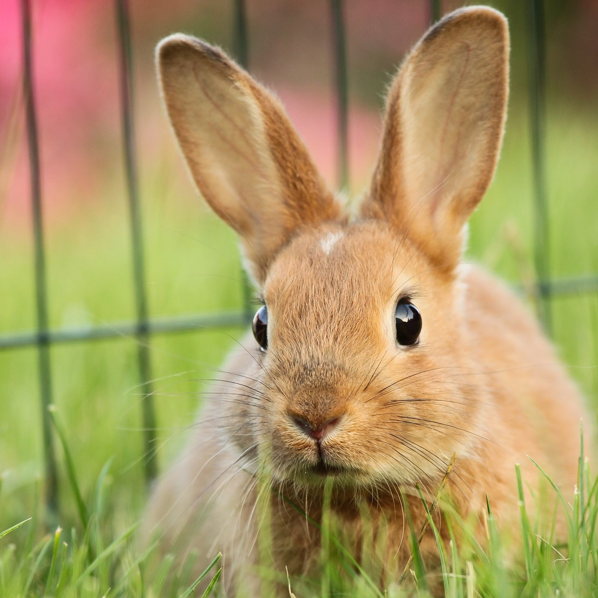
Input Pipeline
A series of input data processing before training
Rotate

Slide 15




Input Pipeline
A series of input data processing before training
Shuffle

Slide 16
Input Pipeline
A series of input data processing before training
Batch

Slide 17
Input Pipeline
A series of input data processing before training
Building the input pipeline is long and painful, and it’s hard to reuse due to different type of data
TensorFlow provides an API tf.data enables you to build complex input pipelines from simple, reusable pieces

Slide 18
Input Pipeline - TensorFlow
To apply transformations on your input data, we will need to construct a tf.data.Dataset object

Slide 19
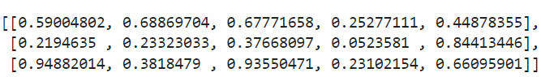
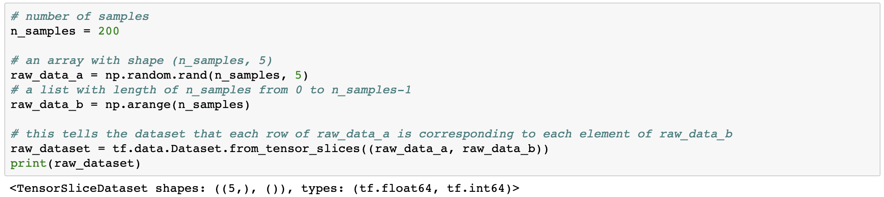
Input Pipeline - TensorFlow
raw_data_a:
...
Construct Dataset
For small data (in-memory)
raw_data_b: [ 0, 1, 2, … , 199 ]
All input tensors must have the same size in their first dimensions
The given tensors are sliced along their first dimension.

Slide 20
Input Pipeline - TensorFlow
Construct Dataset
For small data (in-memory)
data
label

Slide 21
Input Pipeline - TensorFlow
Transformations
Map: apply the function to each the elements of this dataset
Shuffle: maintains a fixed-size buffer and chooses the next element uniformly at random from that buffer
Batch: combines consecutive elements of this dataset into batches
Repeat: repeat this dataset so each original value is seen multiple times
Prefetch: allows later elements to be prepared while the current element is being processed

Slide 22
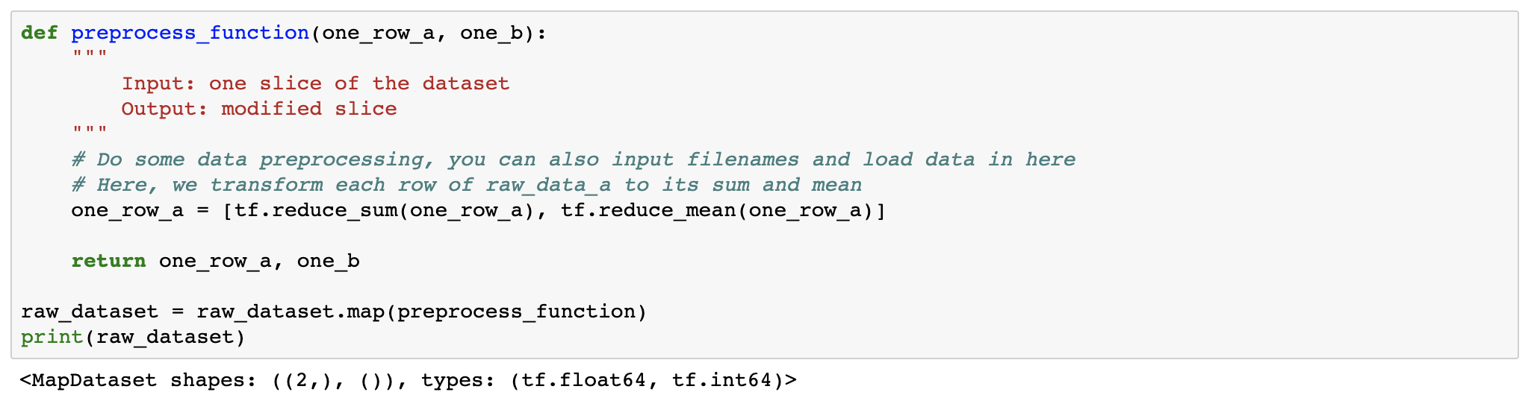
Input Pipeline - TensorFlow
Transformations
Map: apply the function to each the elements of this dataset
Map function
reduce the dimension

Slide 23
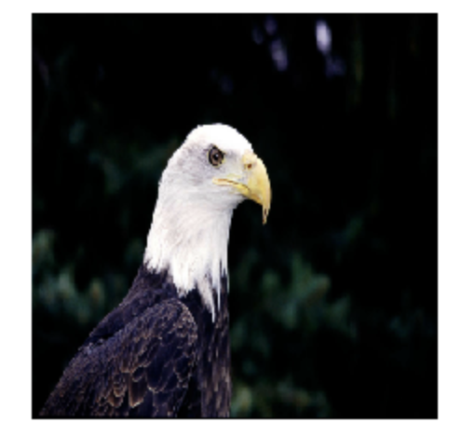
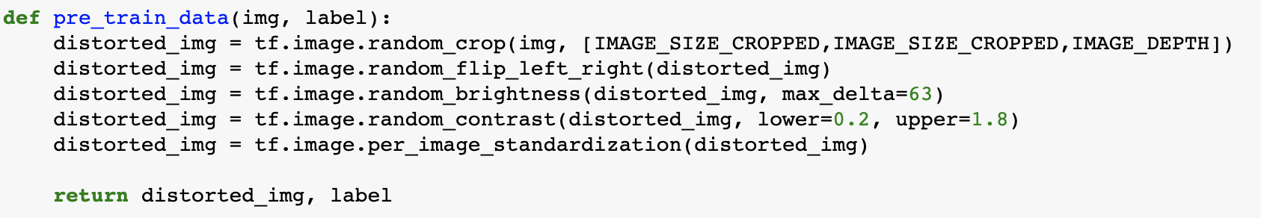
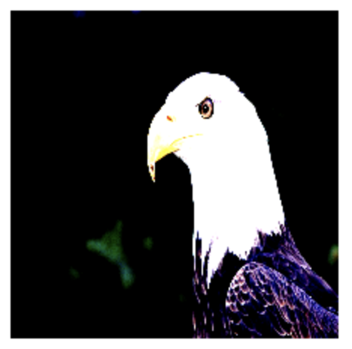
Input Pipeline - TensorFlow
Transformations
Map: apply the function to each the elements of this dataset
Data augmentation: a technique to increase the diversity of your training set by applying random transformations such as image rotation

Slide 24
Input Pipeline - TensorFlow
Transformations
Shuffle: maintains a fixed-size buffer and chooses the next element uniformly at random from that buffer
Buffer size
data 1
data 2
data 1
data 1
data 3
data 2
data 5
data 2
data 4
Buffer size: 4
data 3
Output
data 3
data 5
data 4
data 4
data 6
Buffer
Buffer

Slide 25
Input Pipeline - TensorFlow
Transformations
Batch: combines consecutive elements of this dataset into batches
Be careful that if you apply shuffle after batch, you'll get shuffled batch but data in a batch remains the same
shuffle -> batch
batch -> shuffle

Slide 26
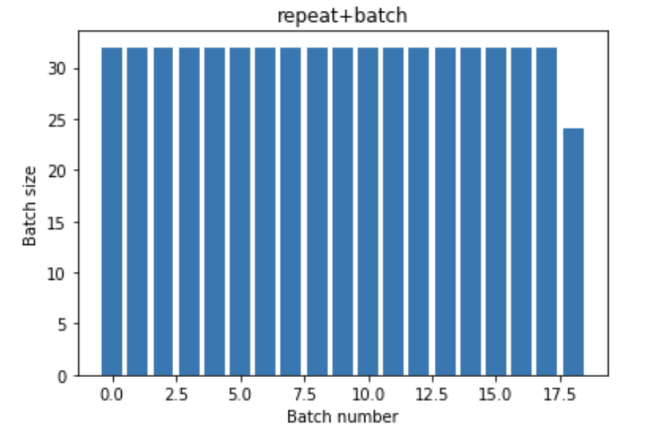
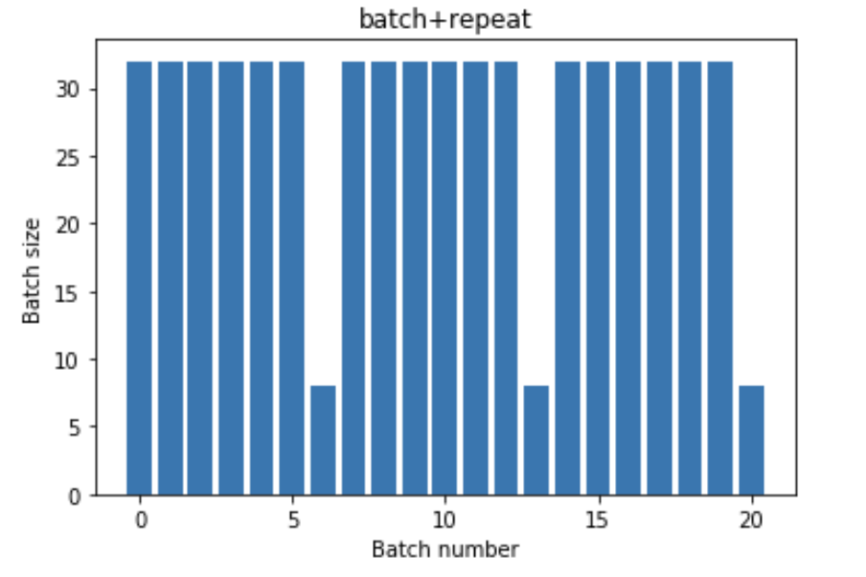
Input Pipeline - TensorFlow
Transformations
Repeat: repeat this dataset so each original value is seen multiple times

Slide 27
Input Pipeline - TensorFlow
Transformations
Prefetch: allows later elements to be prepared while the current element is being processed
This often improves latency and throughput, at the cost of using additional memory to store prefetched elements
it will prompt the tf.data runtime to tune the value dynamically at runtime

Slide 28
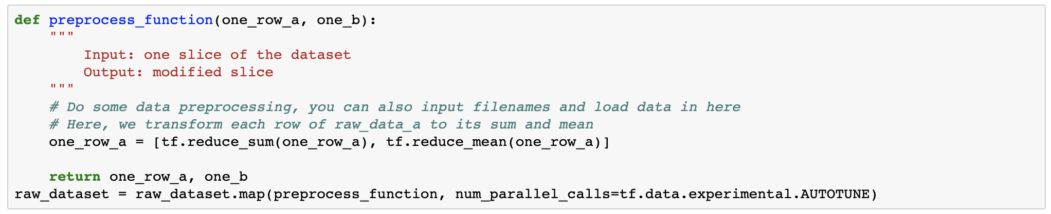
Input Pipeline - TensorFlow
Transformations
Prefetch: allows later elements to be prepared while the current element is being processed
This often improves latency and throughput, at the cost of using additional memory to store prefetched elements

Slide 29
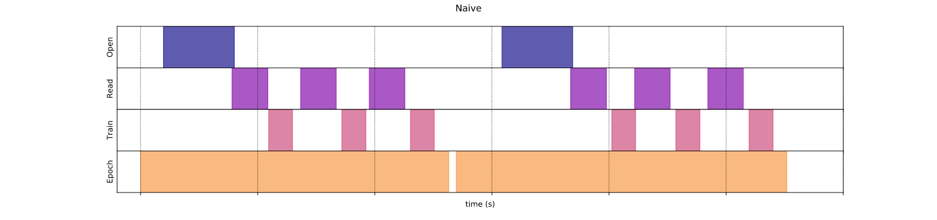
Input Pipeline - TensorFlow
Transformations
Prefetch: allows later elements to be prepared while the current element is being processed
it will prompt the tf.data runtime to tune the value dynamically at runtime

Slide 30
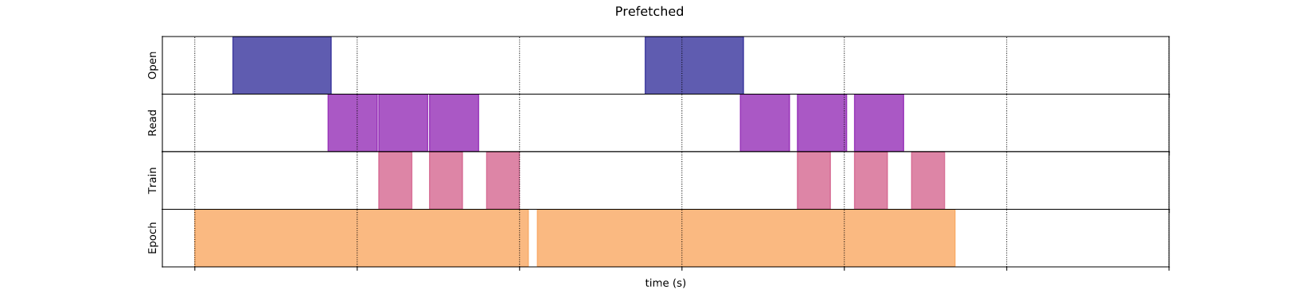
Input Pipeline - TensorFlow
Transformations
Prefetch: allows later elements to be prepared while the current element is being processed
it will prompt the tf.data runtime to tune the value dynamically at runtime

Slide 31
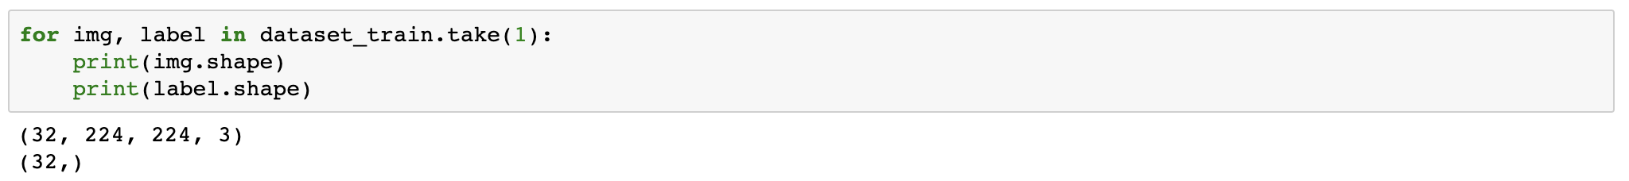
Input Pipeline - TensorFlow
Now you can iterate through the data and train
Aware that if you do batch, the first dimension will be the batch size

Slide 32
Memory limited?
200 * 5 * 8 byte ~ 7.8KB
raw_data_a:
...
Construct Dataset
For small data (in-memory)
raw_data_b: [ 0, 1, 2, … , 199 ]
data
label
What if x_train are 4000 colored images with (height, width) =(1024,1024)?

Slide 33
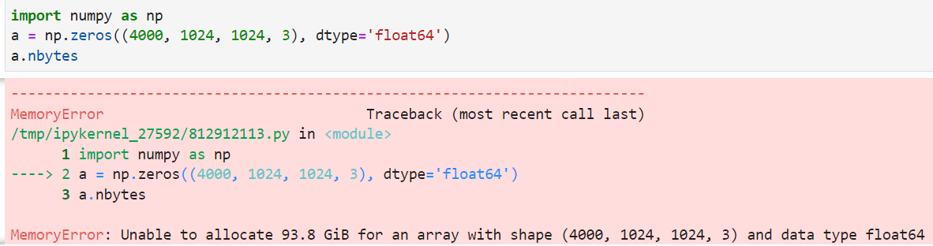
Memory limited?
200 * 5 * 8 byte ~ 7.8KB
raw_data_a:
...
Construct Dataset
For small data (in-memory)
raw_data_b: [ 0, 1, 2, … , 199 ]
(CPU Memory, irrelative to smaller batch size
data
label
What if x_train are 4000 colored images with (height, width) =(1024,1024)?

Slide 34
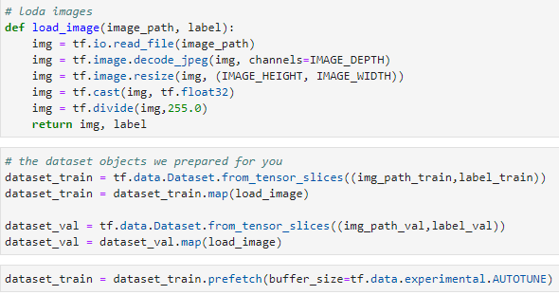
Memory limited?
Use image path as x_train, rather than digits of pixels directly
Load digits during training (prefetch)

Slide 35
Outline
Convolution neural network
Input pipeline
Optimization for Input pipeline

Slide 36
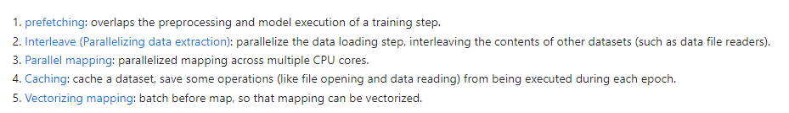
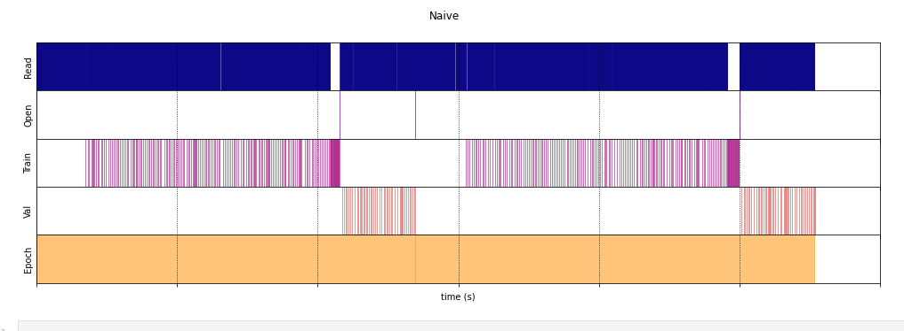
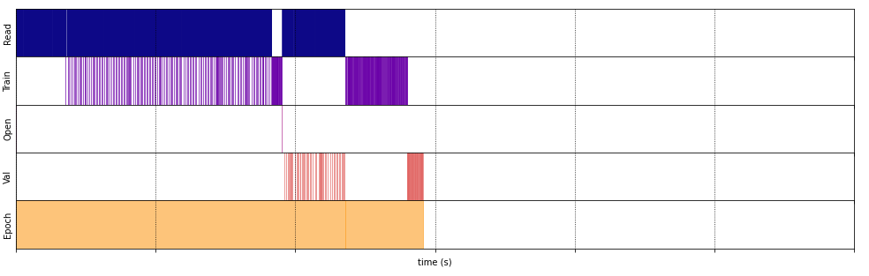
Optimization for Input pipeline

Slide 37
Assignment
Goal
Try some the input transfromation mentioned above (e.g. shuffle, batch, repeat, map(random_crop, random_flip_left_right, ...)) but without optimization terms (e.g. prefetch, cache, num_parallel_calls), comparing the performance to the no input transfromation
Retrain your model with optimized terms, compare the time consuming
Training both models above for at least 3 epochs
Briefly summarize what you did and explain the performance results (accuracy and time consuming)
Deadline: 2024/10/30 (Thr) 23:59

